Slide 1

BITS CloudReady™
Simulated Business Network on AWS
Professional Demo Presentation

Slide 2

AWS Console & VPC

Slide 3
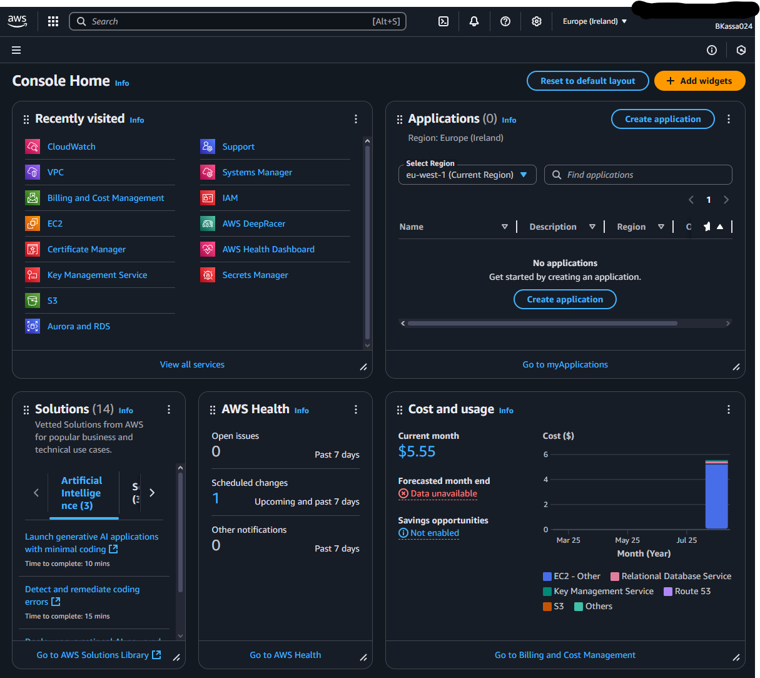
AWS Console Home

Slide 4
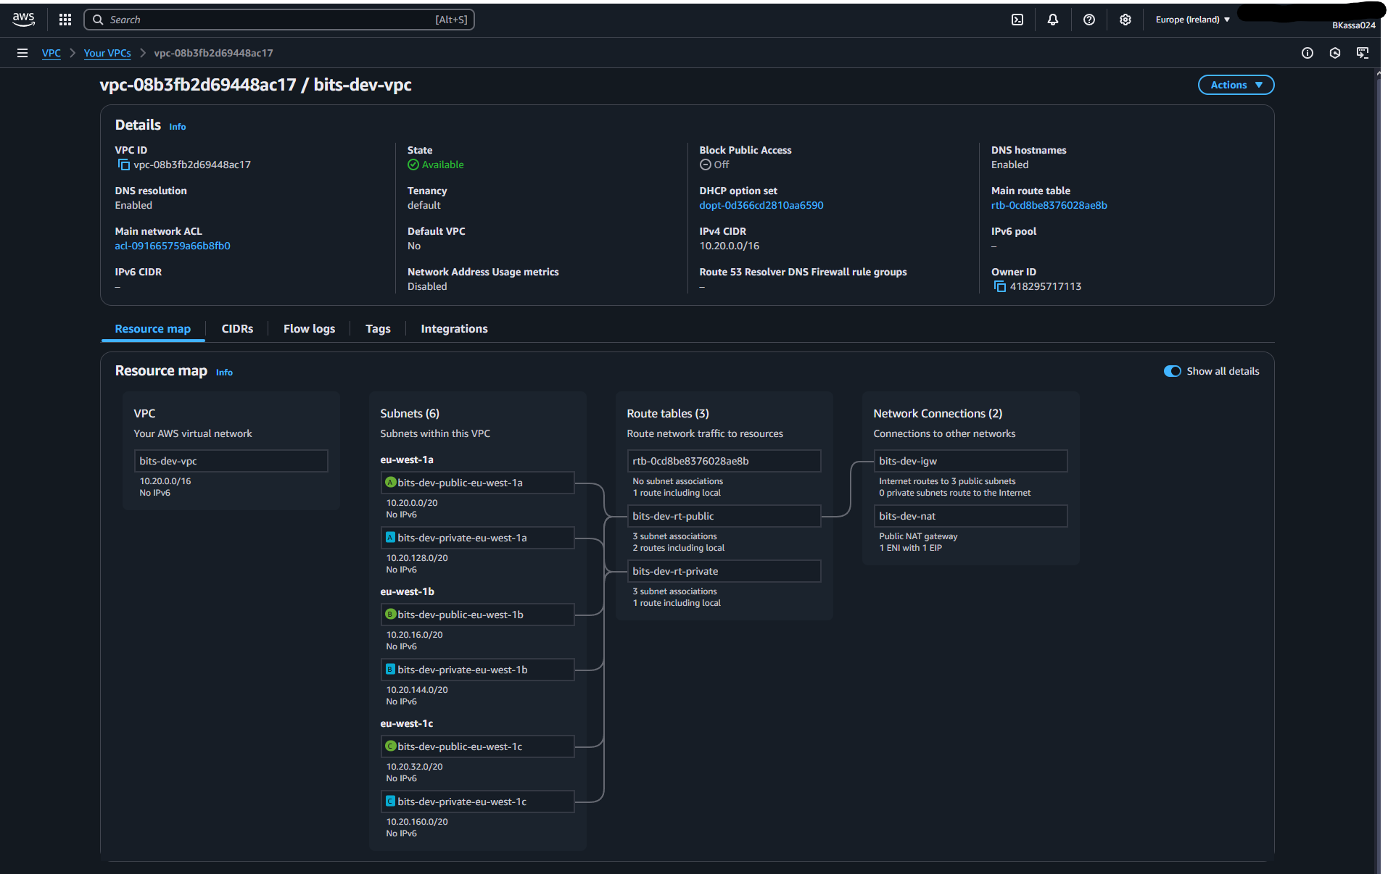
VPC Resource Map

Slide 5

Routing

Slide 6
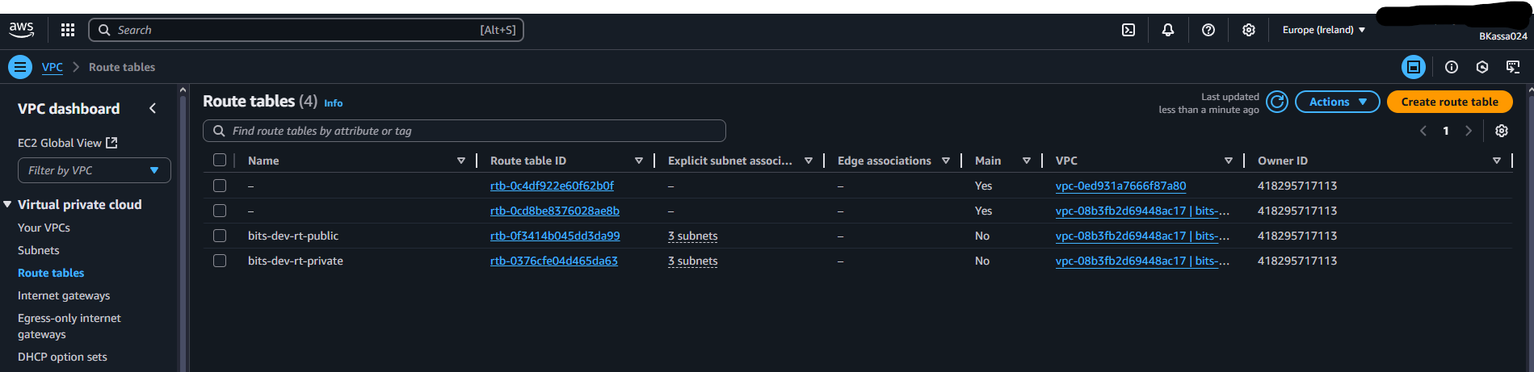
Route Tables

Slide 7
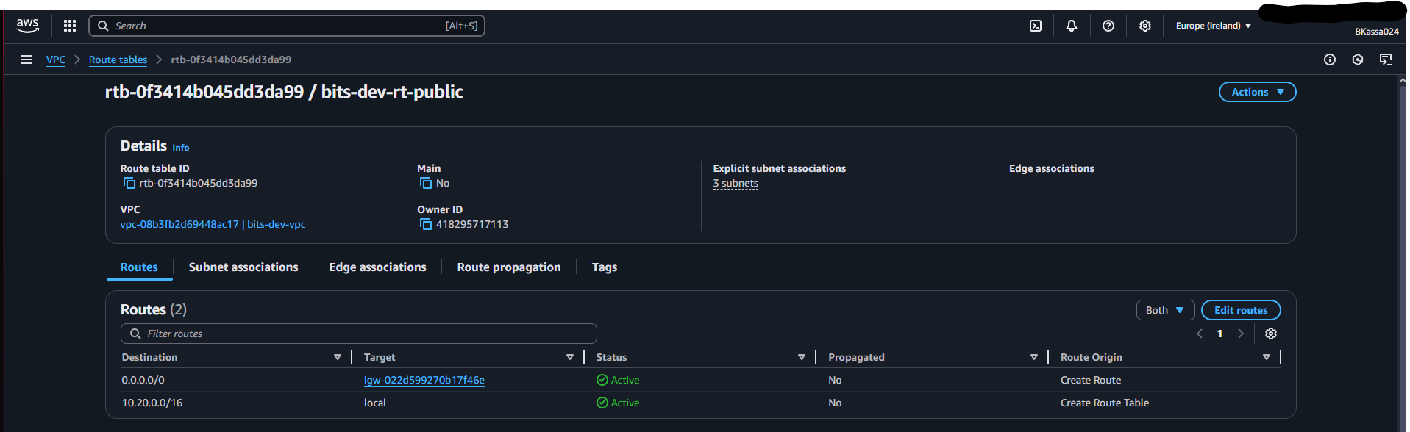
Public Route Table

Slide 8
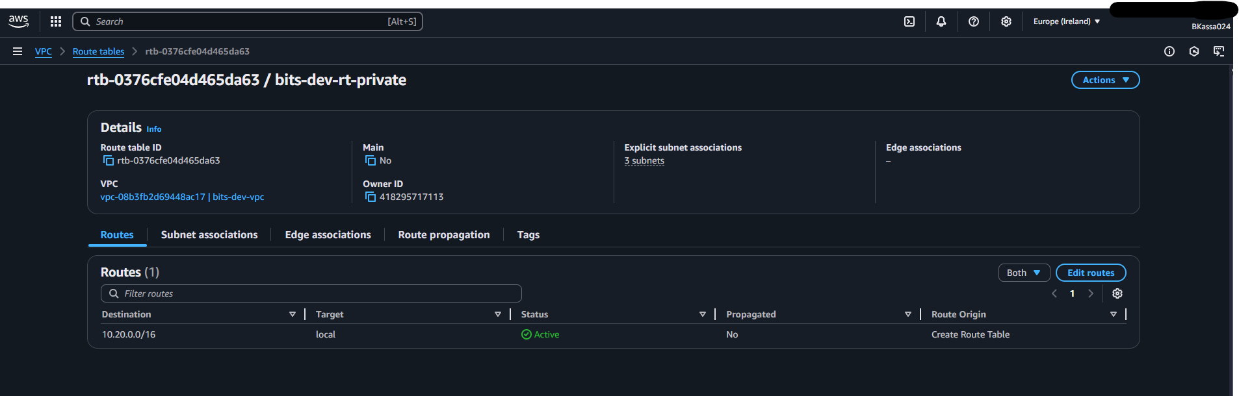
Private Route Table

Slide 9

Security Groups

Slide 10
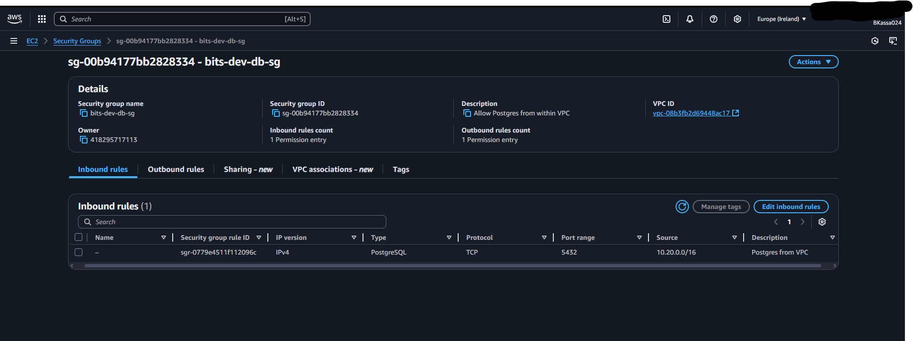
DB SG Inbound

Slide 11
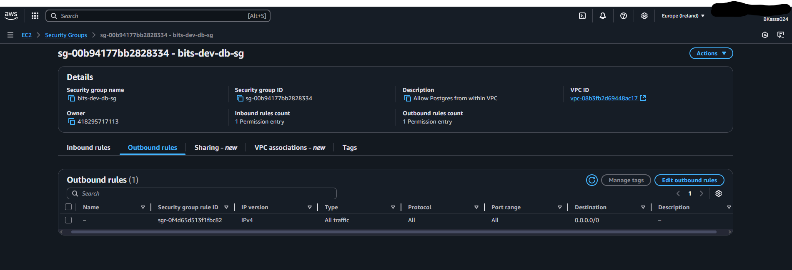
DB SG Outbound

Slide 12

Compute & Data

Slide 13
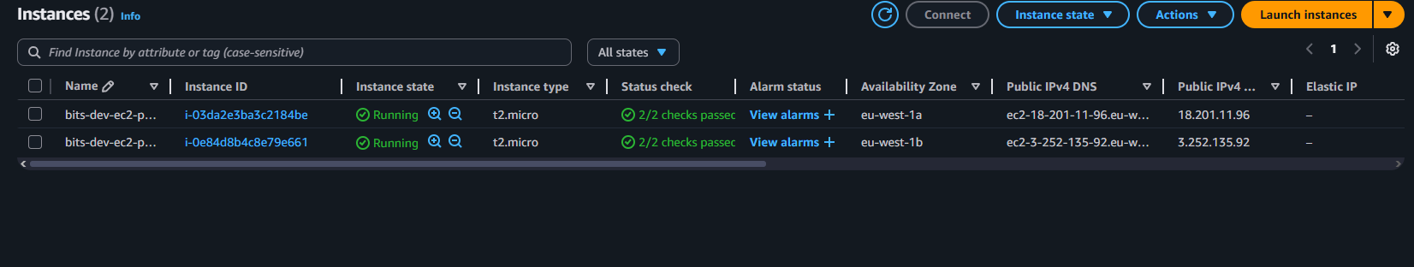
EC2 Instances

Slide 14
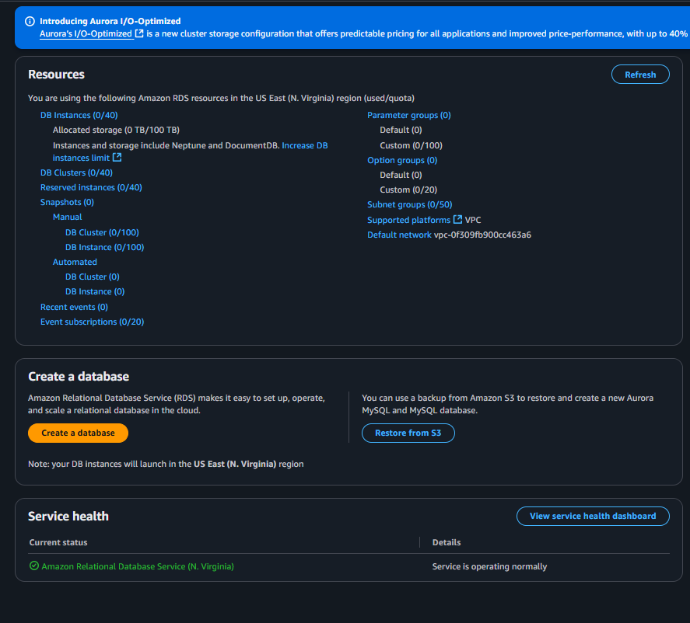
RDS Dashboard

Slide 15

Storage

Slide 16
Storage (S3)

Slide 17
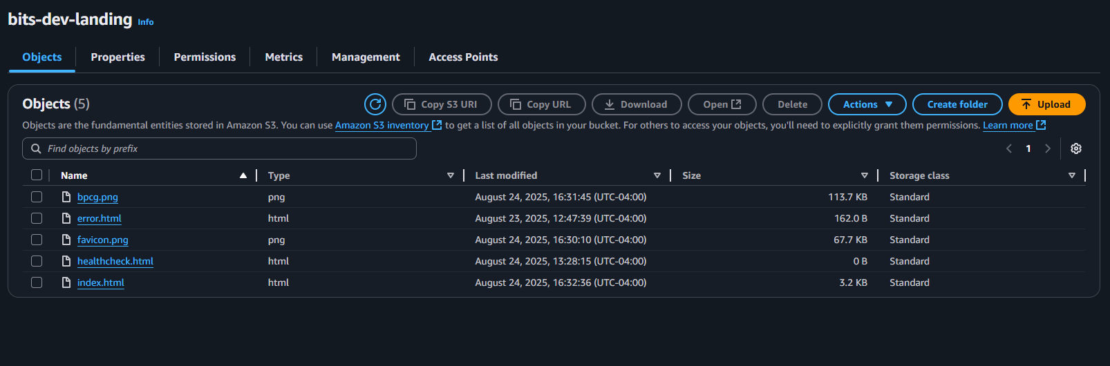
Landing Objects

Slide 18
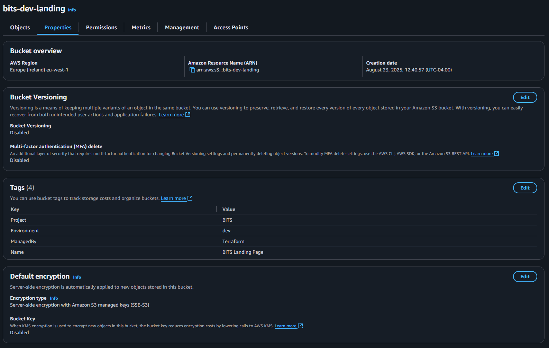
Landing Properties

Slide 19
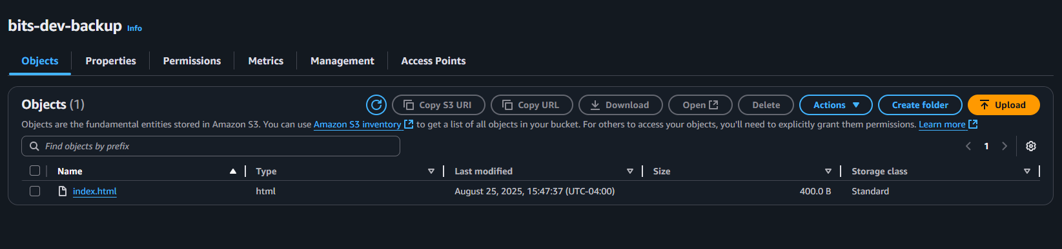
Backup Objects

Slide 20
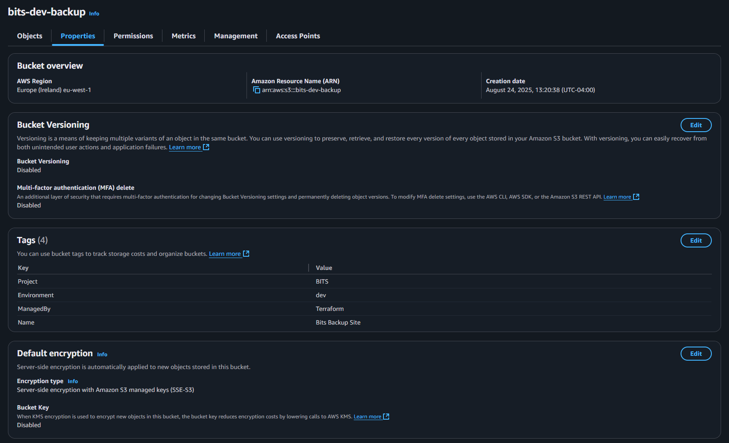
Backup Properties

Slide 21

Encryption (KMS)

Slide 22
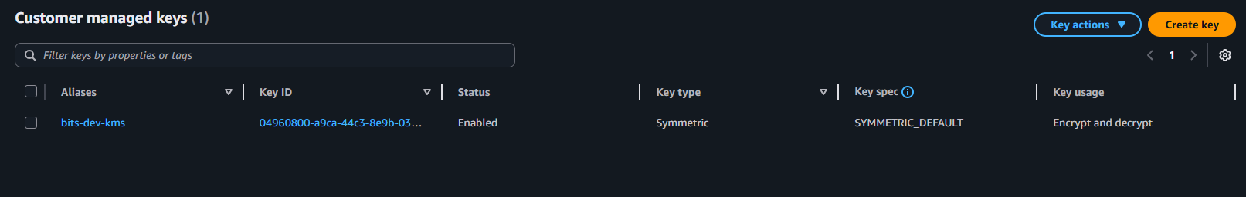
KMS Keys

Slide 23
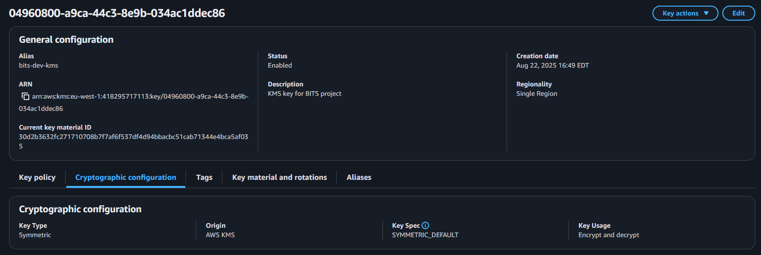
KMS Key Details

Slide 24

Observability & Cost

Slide 25
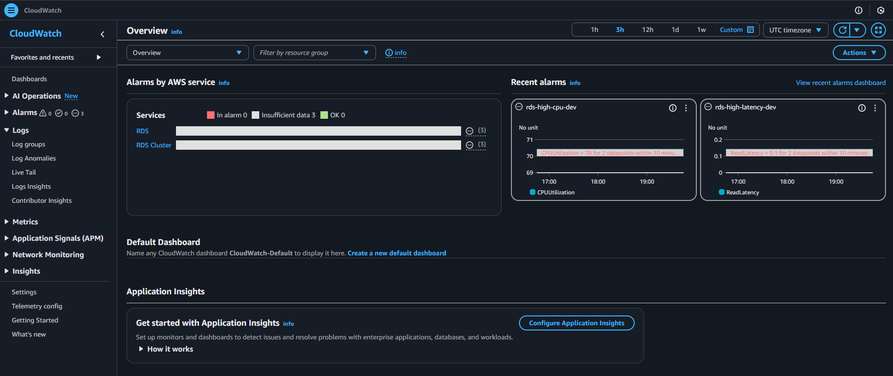
CloudWatch Overview

Slide 26
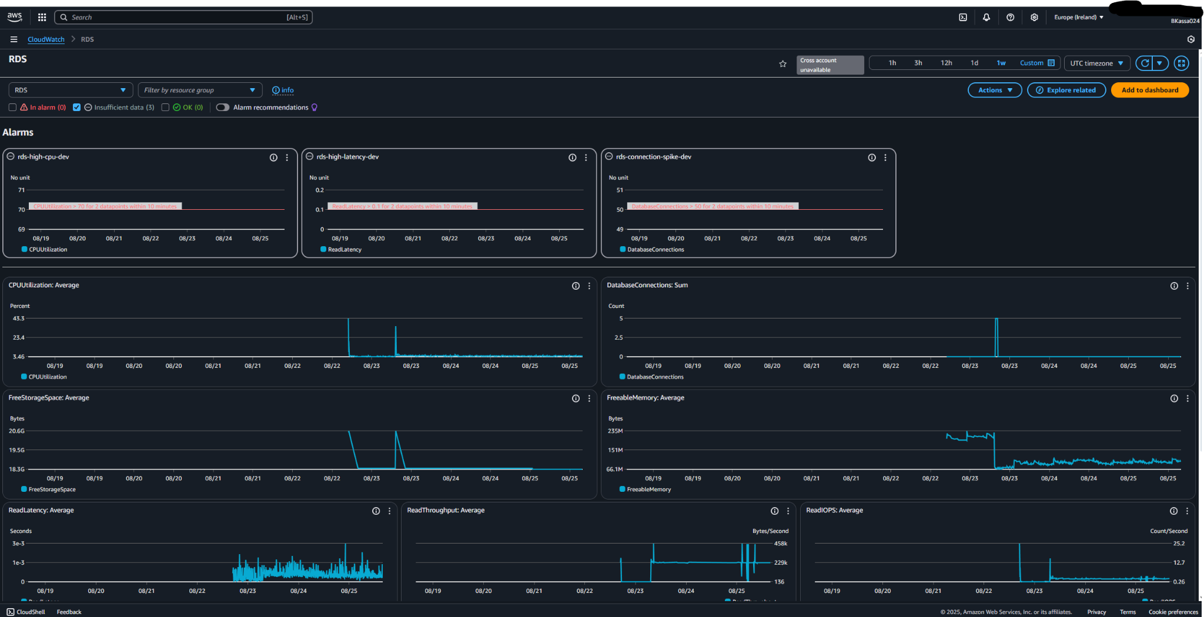
CloudWatch RDS Metrics

Slide 27
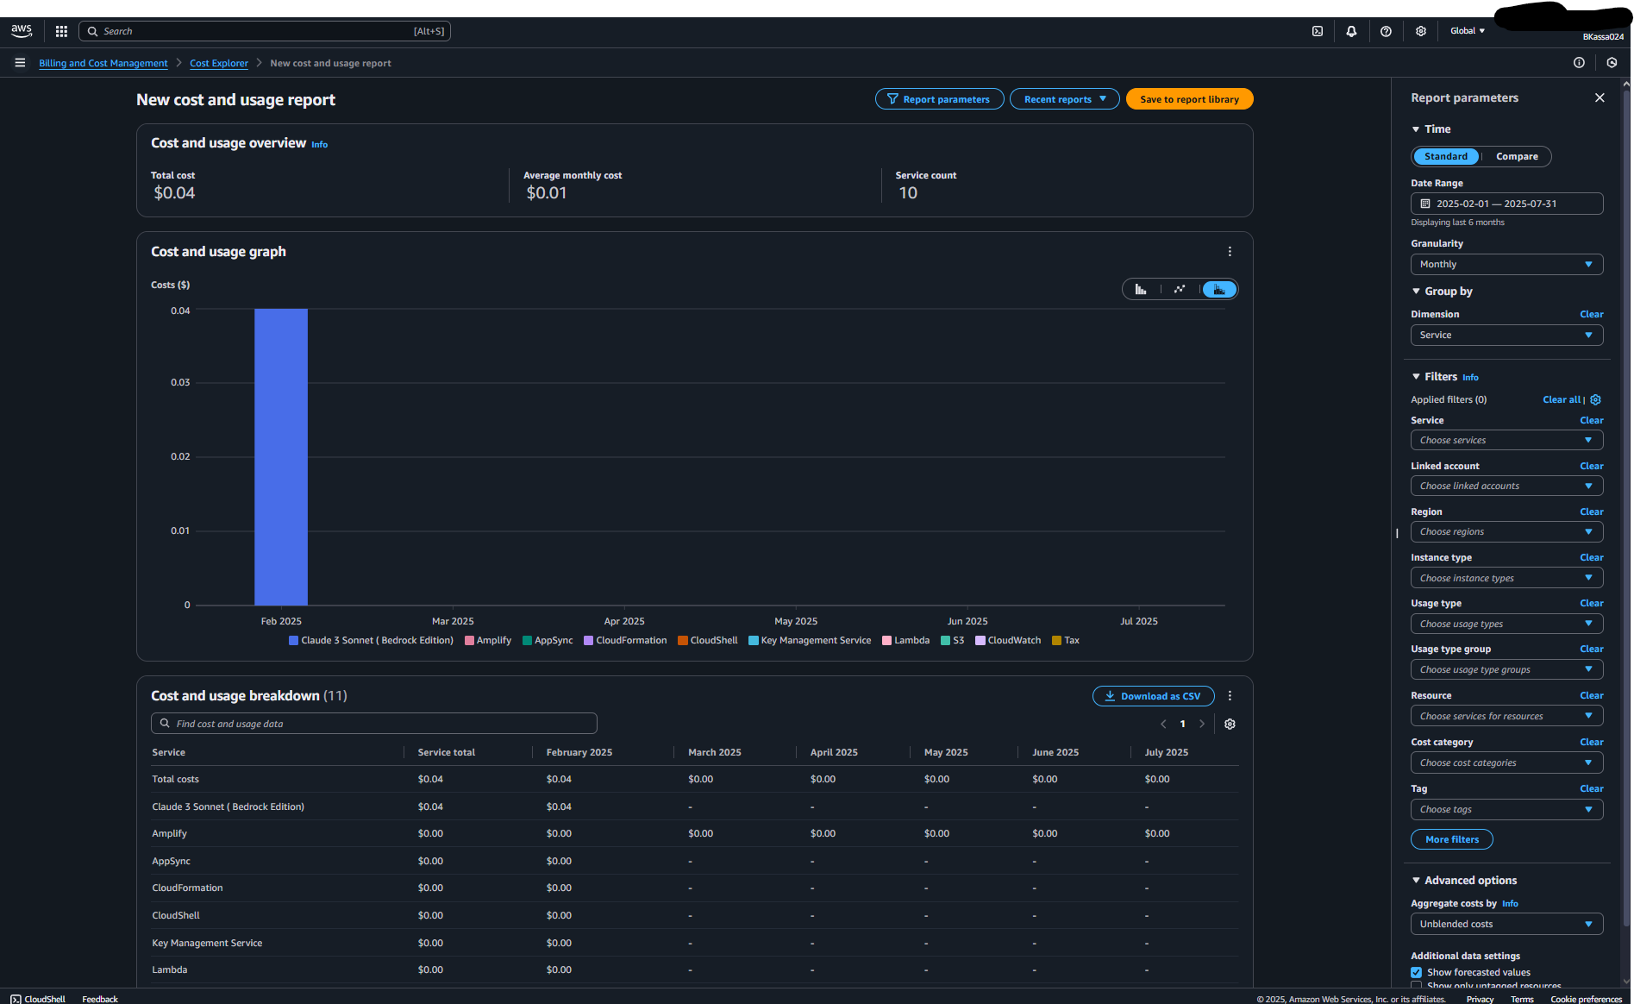
Cost Explorer

Slide 28

Infrastructure-as-Code [IaC]

Slide 29
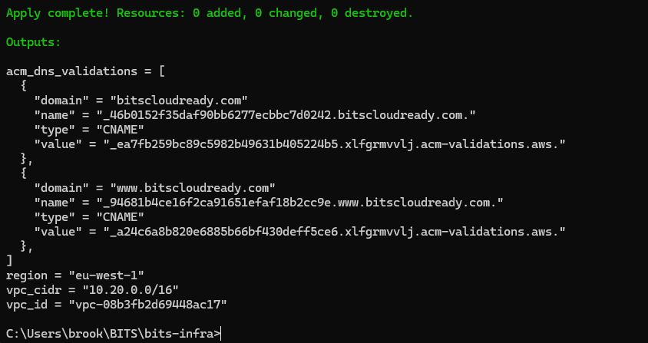
Terraform Validation

